Slide 1
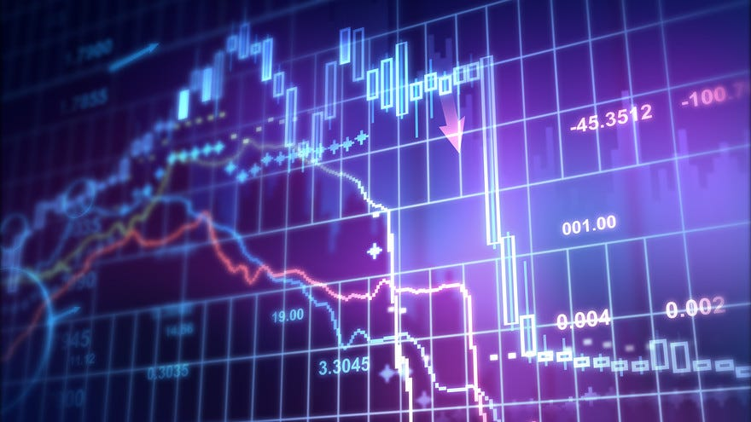
AI Powered Finance Assistant
Disclaimer: This project is made for educational purpose only. We are not asking to buy any stocks.

Slide 2

Introduction:
A mutual fund is an investment vehicle that pools money from several investors to invest in a mix of assets like stocks, bonds, government securities, and even gold. Mutual funds allow investors to achieve portfolio diversification and professional management, with returns and risks based on the performance of the fund’s investments.
The funds are managed by financial experts called fund managers. These professionals have the skills to analyze and make investment decisions. To manage the fund, the AMC (Annual Maintenance Charges) / a fee is charged.

Slide 3

Problem Statement
There is a requirement of AI based Finance Assistant which can give proper suggestions based on available data of stocks, based on past performance and available capital with an individual, like Mutual Fund Managers.

Slide 4
Objective
To build an AI based Finance Assistant which can suggest top 10 stocks for the available capital of an individual and with possible buying quantity of each stock ,based on following criterion :
1. Financial performance of stock based on available stock prices
2.PE Ratio : Price to Earnings Ratio is the ratio of share price of a stock to its earnings per share (EPS)
3. PB Ratio: The price-to-book ratio is a financial metric that compares a company's market value to its book value.
4. Financial reports : Quarterly and Annually reports
5.Market sentiments regarding stocks using RNN.

Slide 5

Methodology
PLEASE ENTER INVESTMENT AMOUNT
LARGE CAPS
MID CAPS
SMALL CAPS
ENTER TENURE IN YEARS
NIFTY 50
BSE 30
MULTI CAPS
DETAILS OF STOCKS WITH QUANTITY WITH VARIABLE PARAMETERS
EXPECTED % RETURNS
May I help you?

Slide 6

Implementation domain and platforms required
PYTHON
NUMPY,PANDAS,MATPLOTLIB,SEABORN LIBRARIES : EDA
MACHINE LEARNING
SCIKITLEARN LIBRARIES : Model Building
DNN
KERAS: Model Building
RNN: Sentiment Analysis
React JS
MySQL

Slide 7
Flow Chart
Start
Input: Available Capital
Data Collection
Stock Prices
PE Ratio Calculation
PB Ratio Calculation
Financial Reports
Market Sentiment Analysis (RNN)
Stock Ranking & Selection
Calculate Possible Buying Quantity for each Stock
Output: Top 10 Stocks with Buying Quantities
End

Slide 8

Thank you

